Slide 1
Quantum Computing
By Martin O’Reilly

Slide 2
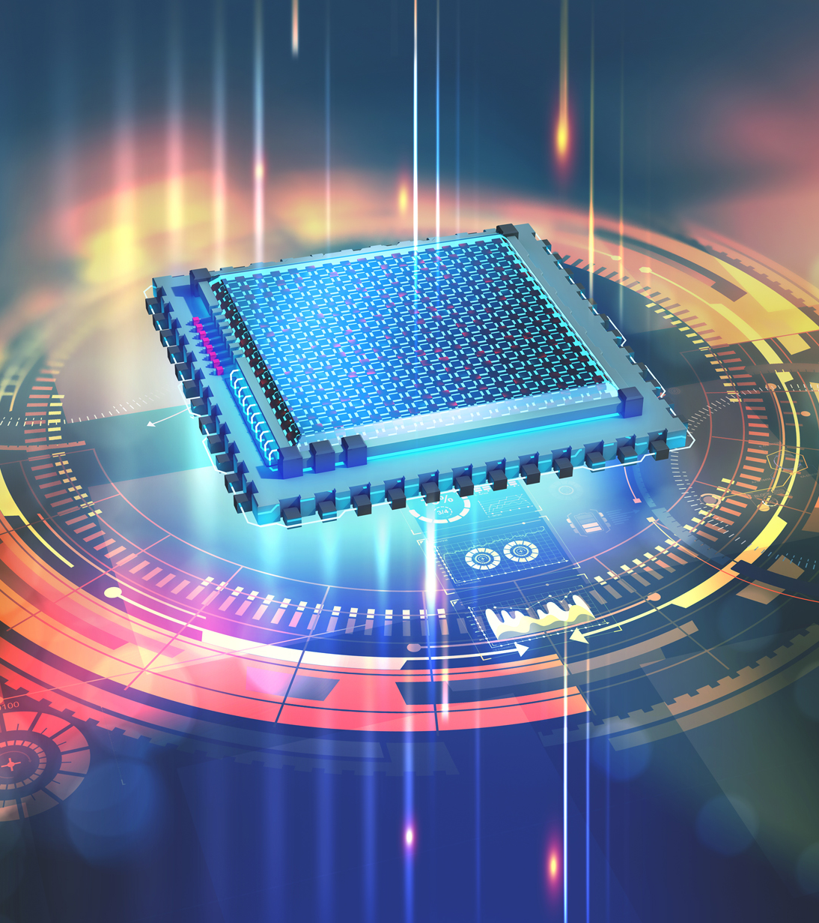
What is Quantum Computing?
A quantum computer is a computer which makes use of the quantum states of subatomic particles to store information.
Instead of bits it uses quantum bits, also known as qubits
Allows for calculations to be done exponentially faster than even the most powerful of supercomputers today

Slide 3

Why don’t we have it yet?
These computers do actually exist, just in very limited capacity
New computation methods would require new languages
Extreme environmental conditions are required

Slide 4
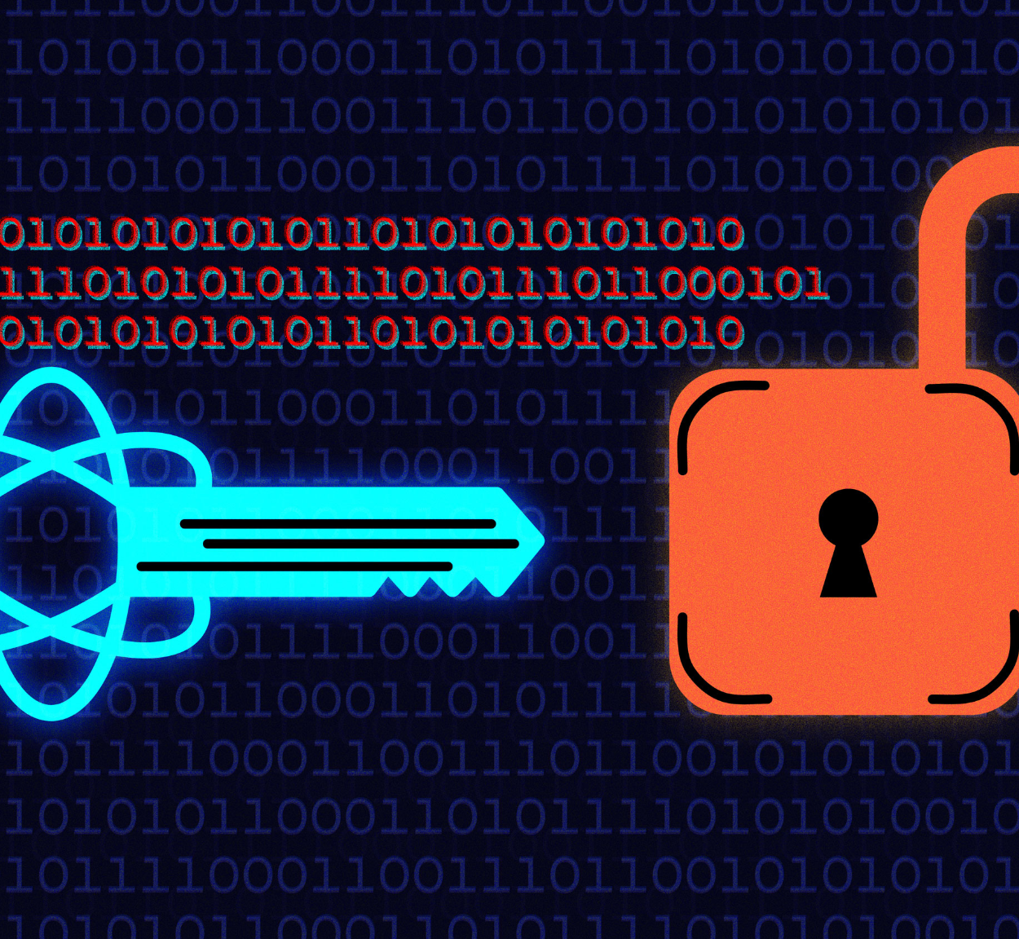
How would this affect cryptography?
Much faster computations
Efficient prime factorization
Fast cryptocoin mining

Slide 5

What is the encryption of the future?
Some encryption methods today are seen as quantum-proof
Quantum computing will allow for new encryption methods
Perhaps nothing will change

Slide 6
Citations
How IBM’s new five-qubit universal quantum computer works
Quantum++: A modern C++ quantum computing library
Quantum computer chips demonstrated at the highest temperatures ever
Waiting for quantum computing: Why encryption has nothing to worry about
Quantum Encryption vs. Post-Quantum Cryptography (with Infographic) | QuantumXC
https://static1.squarespace.com/static/5a56fca2c027d8a33aa5c48f/t/5dcb32cd12b8a466e3ebb726/1573597906079/Exponential+Growth+11.12.19.pdf

